Slide 1
Download and installation of Git and Python

Slide 2
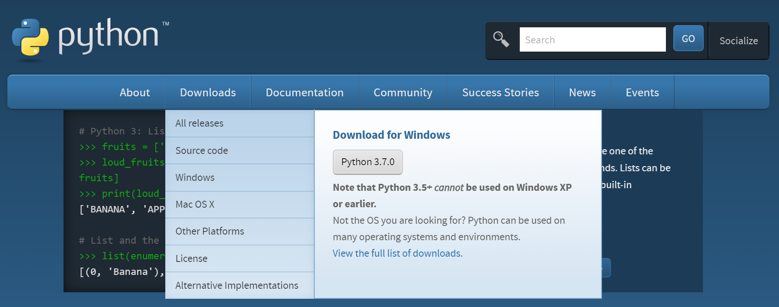
To download Python go to:
https://www.python.org/downloads/

Slide 3
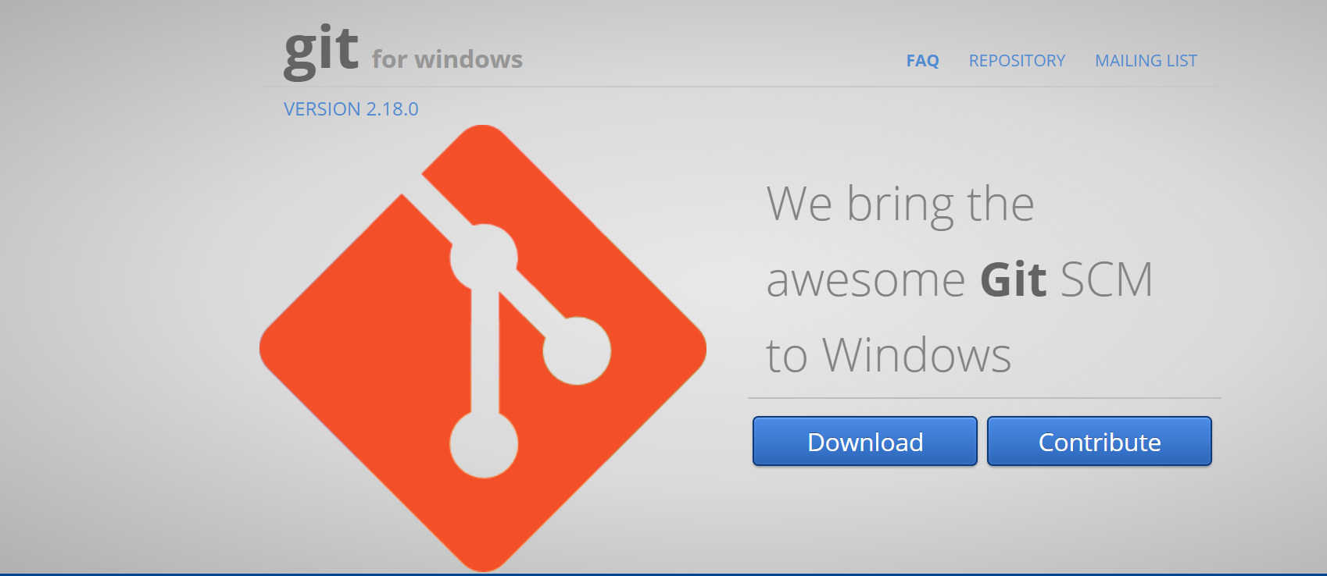
To download Git go to:
https://gitforwindows.org/

Slide 4
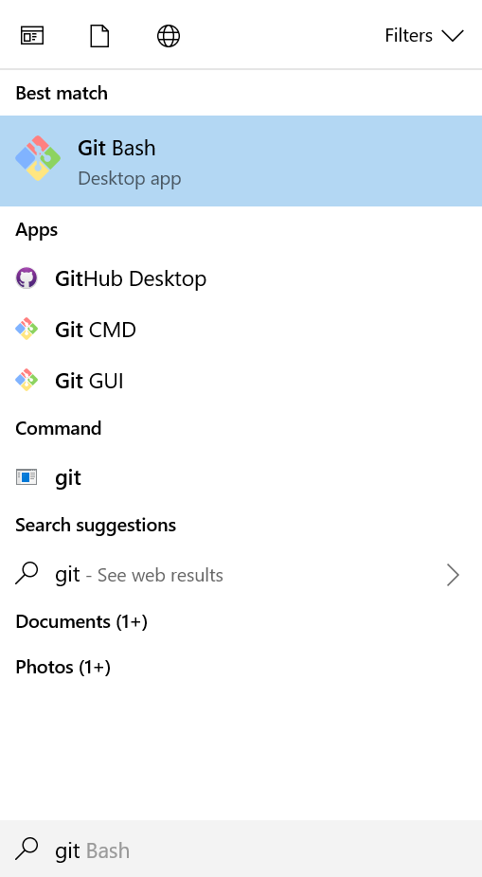
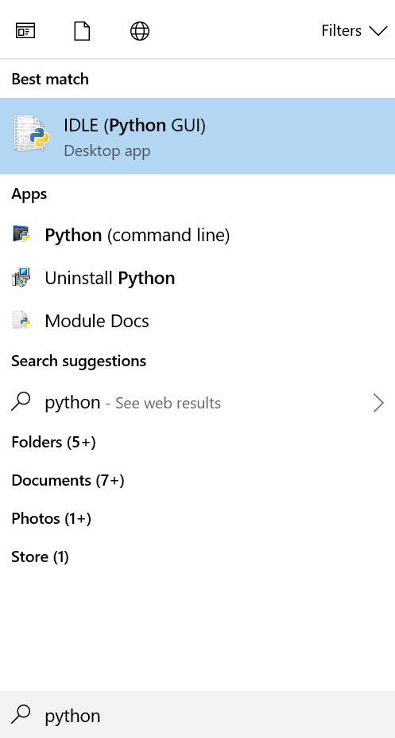
Finding Git and Python

Slide 5
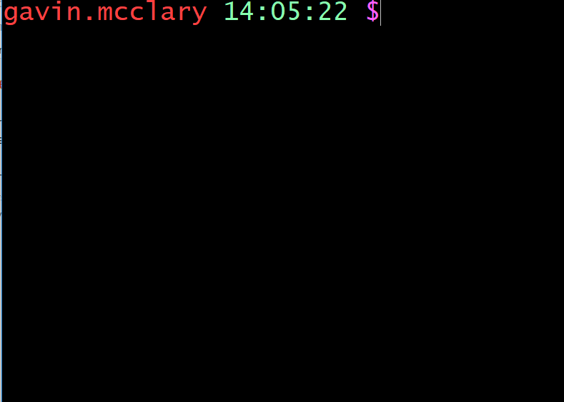
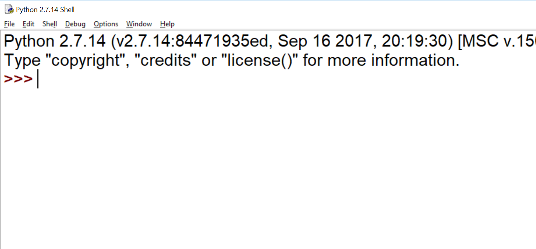
What they look like…
Git
Python (IDLE)

